Slide 1
NVIDIA CHALLENGE
Team: AI Nomads

Slide 2
Team members
First name | Last name | Country
Elizabeth | Mutua | Kenya
Fred Sangol | uche | Gambia
Mbangula Lameck | Amugongo | Namibia
Benson | Mwaura | Kenya

Slide 3
Outline
Background
Approach
Results
Next step

Slide 4
Background
People living in urban areas within Africa require domestic workers to take care of their children. Those without domestic workers take their children to daycares. Modern daycares have software's to manage the operations of the centers but do not have an application to track the mobility of children within the center.

Slide 5
Approach
Our approach is to develop an AI-smart surveillance system that monitors children in daycare centres and sends alerts to the daycare management in a case when a child has left the vicinity of the school or daycare.

Slide 6
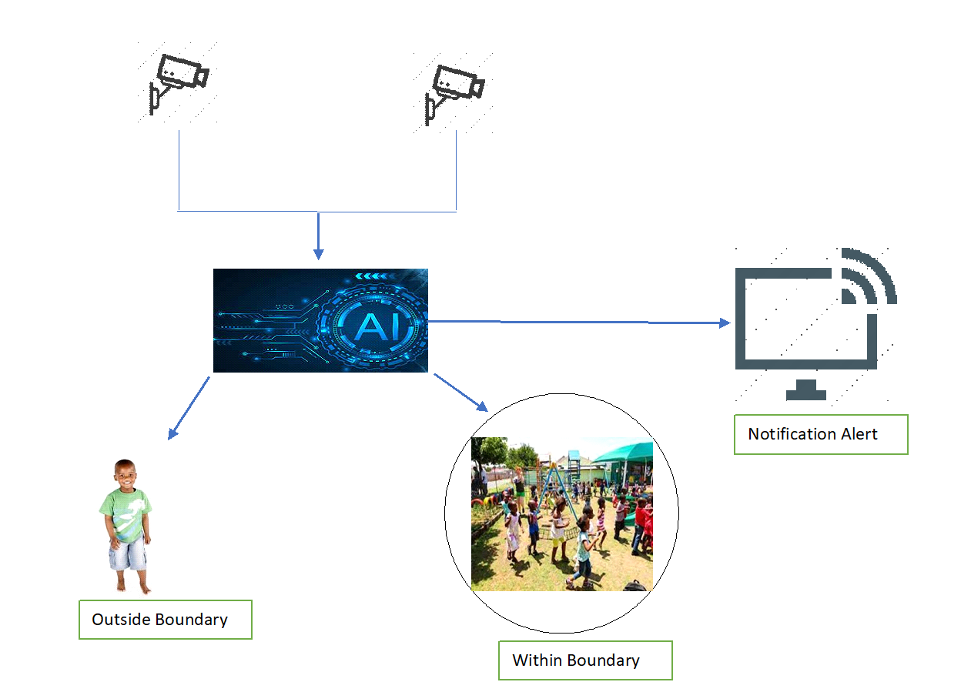
Results
The solution makes use of Peoplenet model from Nvidia NGC and then we provide the dataset with corresponding annotations for this. Results seems to be promising if more time is allowed to work on this project.

Slide 7
Next step
Next step is to build further on this and work towards improving the model’s accuracy. Then later refining the application to be used to real life applications in daycare centers, schools, hotels and religious centers where children are available.

